Slide 1
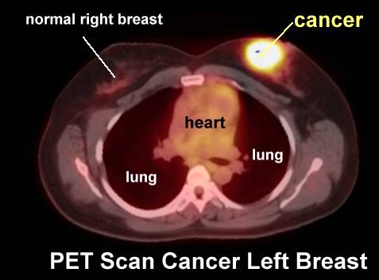
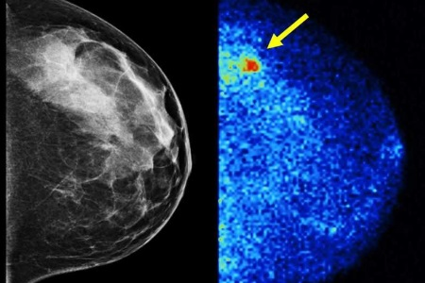
The Role of Nuclear Medicine in the Evaluation of Breast Cancer
Scintimammography: ^{99m}Tc-MIBI
Pr. Dr Hamzeh Chebib
Head The Division of Nuclear Medicine
Department of Oncology
Faculty of Medicine
Tishreen University Hospital
Latakia, Syria

Slide 2
Breast Cancer
Breast cancer is the most common invasive cancer to affect women in the world.
Its the second leading cause of cancer death in women (only lung cancer kills more women each year). The chance that a woman will die from breast cancer is about 1 in 38 (about 2.6%)

Slide 3
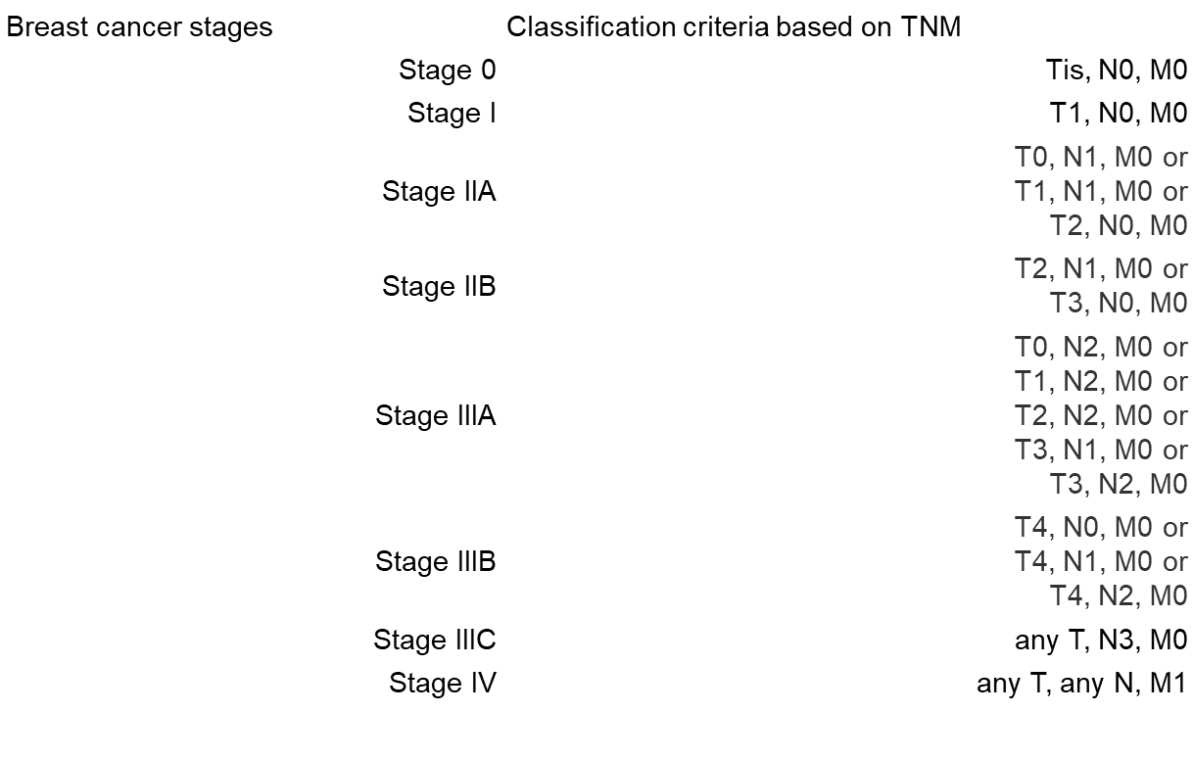
Types ,Stage and Grade of Breast Cancer
Common Types:
-In situ (lobular or ductal)
-lobular carcinoma
-ductal carcinoma
And upon immunohistochemistry analysis: Luminal A,B, HER+ OR -, Triple Negative
Less common:
Tubular,-comedo carcinoma, -mucinous:, -medullary, -inflammatory, -breast lymphoma, -Paget's disease
Tumor grade
Grade 1
(lowest) Well-differentiated breast cells; cells generally appear normal
and are not growing rapidly; cancer arranged in small tubules.
Grade 2 Moderately-differentiated breast cells; have characteristics between Grade 1 and Grade 3 tumors.
Grade 3
(highest) Poorly differentiated breast cells; Cells do not appear normal and tend to grow and spread more aggressively.

Slide 4
ROLE OF NUCLEAR MEDICINE IN BREAST CANCER PATIENTS
STAGING
TREATMENT RESPONSE “RE-STAGING”
RECURRENCE :EARLY DETECTION
SLN: INITIAL STAGING OF AXILLARY LYMPH NODES
BONE SCAN: 99mTc MDP, 18F FDG and 18F-NaF PET-CT scan
DIAGNOSIS As Complementary To Radiologic Method In Special Situation

Slide 5
INSTRUMENTS and RADIOPHARMACEUTICALS
1-Gamma camera & dedicated Gamma camera
¹¹¹In-Trastuzumab
^{99m}Tc-sestamibi (MIBI)
^{99m}Tc-MDP: Bone scan
99mTc-nanocolloid : Sentinel lymph node
-Positron emission tomography : PET Scan
18F-FDG, 18F-fluoroestradiol, 89Zr-Trastuzumab , ⁶⁸Ga-DOTA-F(ab′)2-trastuzumab

Slide 6
Dense breast and implants
PET/CT has a role to play in a selected group of patients, such as those with dense breasts or with implants, for determining tumor multiplicity, for localizing the primary tumor in those patients with metastases of a breast origin when the mammography is indeterminate, and for those patients whom biopsy is not a desirable option

Slide 8
Regional Lymph Node Metastasis
Axillary lymph node metastasis is an important factor when determining the prognosis of patients. Breast cancer patients with four or more involved axillary lymph nodes have a significantly higher risk of recurrence .The sensitivity and specificity of axillary PET imaging in breast cancer patient have been reported as 79-94% and 86-92%, respectively .PET/CT can accurately localize and differentiate the metastatic and reactive lymph nodes when CT shows multiple enlarged lymph nodes in the axilla
Axillary lymph node metastasis in a 45-year-old woman with a 4 cm invasive ductal carcinoma.
A. The PET image shows increased FDG uptake in the right breast (black arrow) and axilla (white arrow).
B. The CT image shows two enlarged lymph nodes in the right axilla (arrows).
C. The PET/CT image shows accurate localization of the metastatic (white arrow, SUV = 9.9) and reactive (black arrow) lymph nodes. Surgery revealed one metastatic lymph node out of the 21 excised axillary lymph nodes

Slide 9
Internal mammary & mediastinal lymph nodes
The metastasis to the internal mammary or mediastinal lymph nodes in breast cancer patients is often clinically occult. The prevalence of abnormal findings for the internal mammary or mediastinal lymph nodes by PET was about twice than of conventional CT in those patients with recurrent or metastatic breast cancer . PET/CT appeared to be more useful than CT for evaluating the internal mammary and mediastinal lymph nodes because the smaller lymph nodes sometimes produced equivocal or negative CT findings
Mediastinal lymph node metastasis in a 41-year-old woman who had undergone left modified radical mastectomy 10 months previously.
A. The PET image shows multiple areas of increased uptake (arrows) in the left upper chest.
B. The CT image shows a small soft tissue density in the anterior mediastinum (arrow).
C. The PET/CT image shows co-registration of the FDG uptake and the soft tissue density in the anterior mediastinum, suggesting internal mammary lymph node metastases (arrow).

Slide 10
Recurrence
Detecting early recurrence has an important survival benefit because it prompts clinical consideration for administering different therapies. However, it is difficult to differentiate true recurrence from postsurgical sequelae and radiation sequelae with using just the conventional imaging modalities. Locoregional recurrences predominately affect the breast, skin, the axillary and supraclavicular nodes, and the chest wall
Local recurrence in a 74-year-old woman who had undergone right modified radical mastectomy eight years previously.
A. Sonography shows an 1.4 cm oval mass with increased vascularity in the right pectoralis muscle at the mastectomy site.
B, C. The PET images show focal high FDG uptake (SUV= 3.3) (arrows) in the right chest wall.
D. The PET/CT image shows a focus of high FDG uptake (arrow) localized to the right pectoralis muscle..

Slide 11
Recurrence
A 43‐year‐old patient, 2 years after mastectomy, was referred for assessment of elevated CA 15‐3 serum levels and a hypodense liver lesion on CT. Selected PET (left), PET/CT (center), and CT (right) images at the level of the chest (A) and pelvis (B) show abnormal FDG uptake in a sclerotic lesion in the anterior aspect of the 2nd left rib (A) and in the right ischium (B). No abnormal uptake is seen in the liver lesion (not shown)..

Slide 12
¹⁸F-NaF PET Vs. ¹⁸FDG PET Scan
Discordant bone findings between FDG PET and 18F-NaF PET in a 61-year-old woman with locally advanced invasive ductal carcinoma of the left breast. (a) Initial staging anterior FDG PET MIP image shows hypermetabolic left axillary nodal metastasis (arrow); no additional FDG-avid lesions were depicted. (b) Anterior 18F-NaF PET MIP image shows malignant osseous involvement of the L2 (black arrow) and C7 (white arrow) vertebral bodies. Note the incidental uptake (arrowheads) bilaterally in the wrists (depicted over the pelvis), a finding that was secondary to arthritis or trauma
Radiographic 2014; 34:1295–1316

Slide 13
Treatment Monitoring: assessment of
neoadjuvant chemotherapy: Interim PET
Chemotherapy in a 35-year-old woman with bilateral breast cancer and bone metastases. A-C. The initial PET (A, B) and PET/CT (C) images show strong FDG uptake (arrows) in both breasts and in multiple spinal levels. D-F. The follow-up PET (D, E) and PET/CT (F) images obtained after three cycles of chemotherapy show markedly decreased FDG uptake in both breasts and in multiple spinal levels.
Korean J Radiol 8(5), October 2007

Slide 14
18F-FDG and 18F-FES PET coronal slices are shown for 2 patients in University of Washington 18F-FES trial. Both patients have mediastinal nodal metastases from ERαpositive breast cancer. Both had biopsy of metastatic site. ER uptake is shown by 18F-FES in patient A but not in patient B. Patient A has 18F-FES uptake at multiple sites; in fact, sites are more prominent on 18F-FES PET than on 18F-FDG PET and can be seen with well-differentiated breast cancer. Patient B has mediastinal disease clearly seen by 18F-FDG PET but not seen on 18F-FES PET. Biopsy showed ERα-negative breast cancer.
THE JOURNAL OF NUCLEAR MEDICINE • Vol. 57 • No. 2 (Suppl. 1) • February 2016

Slide 15
In Conclusion,
FDG-PET or FDG-PET/CT is not recommended for routine lymph node staging, nor for staging patients with I, IIA, or IIB breast cancer. Instead, it should be included into the work-up when distant metastases or recurrent breast cancer are suspected for detection of extra-axillary lymph node metastases and distant metastases ,and when lymph nodes are palpable or locally advanced breast cancer is present
Growing evidence in support for using 18F-­‐FDG PET/CT for initial staging of patients with clinical stage IIB or IIIA BC (stage migration) and in some patients with IIA (triple negative, LABC, HER2+, inflammatory breast cancer ).>>upstaging
PET imaging allows for noninvasive whole body analysis of tumors and may detect previously unsuspected HER2-positive metastases in patients with a HER2-negative primary breast tumor

